Slide 1
Advanced Code Analysis in .NET
Stephen Ritchie
July 10, 2012

Slide 2

Speaker-Rate Me
http://spkr8.com/t/12071

Slide 3
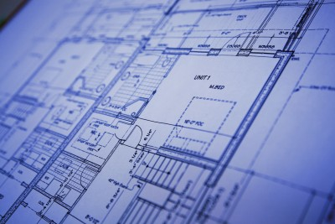
Blueprint

Slide 4
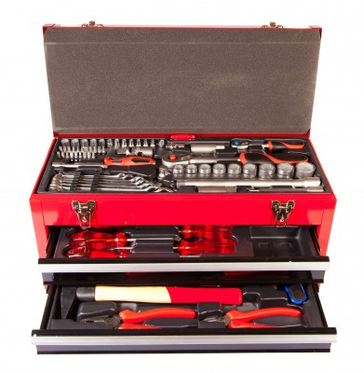
Toolbox

Slide 5

Da Vinci Code … Analyzer

Slide 6
Code Analysis
Static
versus
Dynamic

Slide 7
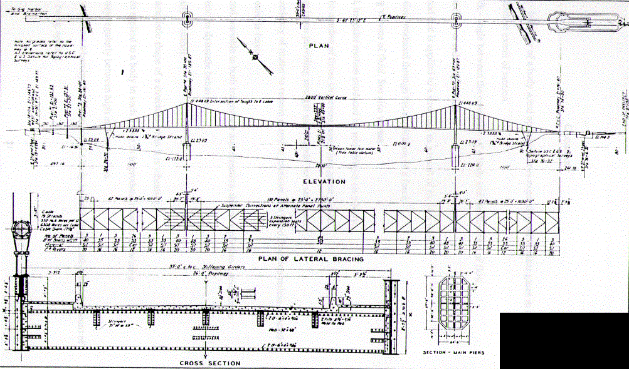
Static Analysis

Slide 8
But wait …
Real Life is Dynamic

Slide 9

1940 Tacoma Narrows Bridge

Slide 10
1940 Tacoma Narrows Bridge
Video
http://archive.org/download/SF121/SF121_512kb.mp4

Slide 11
Static Analysis
Visualizations
Source
Code
Checks
Metrics
Assembly
Detections

Slide 12
Dynamic Analysis
Visualizations
Run the software
Checks
Metrics
Detections

Slide 13
Code Analysis: Objection 1
Sweating the small stuff
Nitpicking
Useless
“Don’t make the same mistake once.”

Slide 14
Code Analysis: Objection 2
Not worth the effort
Low ROI
No Bandwidth
“Crawl, Walk, Run”

Slide 15
Code Analysis: Objection 3
No authorization
Forbidden
Can’t Fix Issues
“Speak truth to power.”

Slide 16
Blueprint
Analyze
1
Monitor
Improve
2
3

Slide 17


Toolbox
FxCop
Detections
Visual Studio
Checks
http://blogs.msdn.com/b/codeanalysis/

Slide 18

Toolbox
StyleCop
Detections
Checks
http://stylecop.codeplex.com/

Slide 19


Toolbox
ReSharper
http://www.jetbrains.com/resharper/
Detections
Checks
Gendarme
http://www.mono-project.com/Gendarme

Slide 20




The Master Craft

Slide 21

Toolbox
Simian
Detections
http://www.harukizaemon.com/simian/

Slide 22

The Master Craft
Duplicates Finder .NET
http://www.jetbrains.com/teamcity/
Clone Doctor
Semantic Designs
http://www.semdesigns.com/Products/Clone/

Slide 23
Dynamic Analysis
Run the software
Code Coverage

Slide 24

Toolbox
dotCover
Metrics
http://www.jetbrains.com/dotcover/

Slide 25

Toolbox
Open Cover
Metrics
http://nuget.org/packages/OpenCover

Slide 26

The Master Craft
http://www.ncover.com/

Slide 27
Dynamic Analysis
Run the software
Sampling
Instrumentation

Slide 28

Toolbox
Performance
Metrics
Visualizations
Detections

Slide 29

Toolbox
Performance
Metrics
Visualizations
Detections
http://www.jetbrains.com/profiler/

Slide 30

The Master Craft

Slide 31
The Master Craft
Memory
Queries
Logging
Security

Slide 32
Static Analysis
Visualizations
Source
Code
Checks
Metrics
Assembly
Detections

Slide 33


The Master Craft
Code Quality
Visualizations
http://www.ndepend.com/
Checks
Metrics
Detections
http://www.lattix.com/

Slide 34

Hanselman’s Placemat
http://bit.ly/LwKfwK

Slide 35
Shameless Self-promotion
http://amzn.to/v8TD8E

Slide 36
Stephen’s Contact Info
Twitter: @ruthlesshelp
Email: stephen.ritchie@excella.com
Blog: http://ruthlesslyhelpful.net
LinkedIn: http://www.linkedin.com/in/sritchie

Slide 37
Speaker-Rate Stephen
http://spkr8.com/t/12071

